Slide 1

The IoD Student Mentoring Scheme Introduction for new mentors
Jenni Jones
jenni.jones@wlv.ac.uk
The University of Wolverhampton Business School & Law School

Slide 2
Our plan for the next hour
Introductions
An overview of our mentoring scheme
Mentoring, key skills and the mentoring lifecycle
A chance to hear from some current mentors
Q&As
Then, later on…
Meet some (more) of our current mentors
Meet some of our mentees ☺
Meet your mentee(s)

Slide 3
Introductions to each other
Please share 4 sentences;
Name
Current position
Mentoring experience
Mentoring ‘super power’

Slide 4
The University of Wolverhampton
Anchor institution for the Black Country
Social justice is central to our mission and we pride ourselves on being the University of Opportunity
UoW student body mirrors diverse communities in the Black Country (80% are from a 20 mile radius)
54% of students are Black and Minority Ethnic (BAME/Global Majority)
67% from the most disadvantaged backgrounds IMD Quintiles 1&2
68% first in family to attend university – no reference point
50% of our undergraduate students are mature
Recognition of intersectionality – considerations of multiple characteristics/identities = inclusivity framework

Slide 5
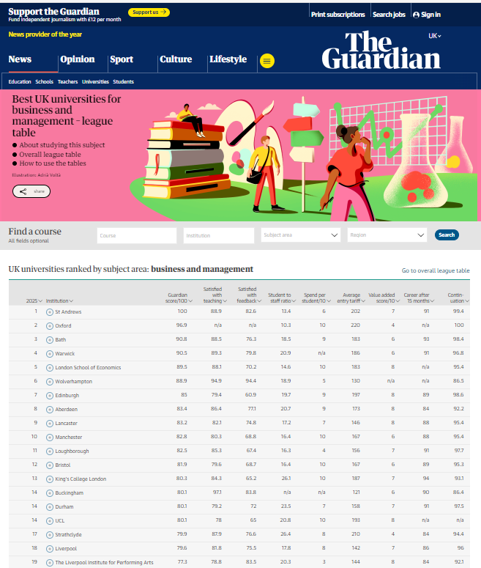

Slide 6
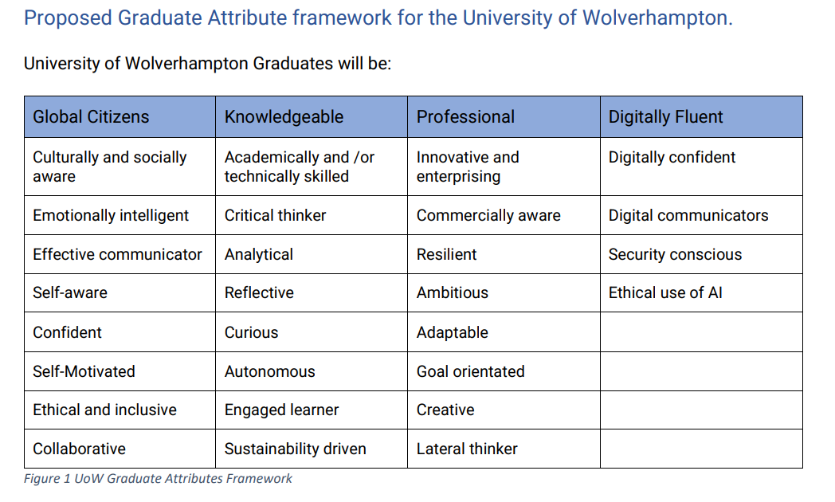
What type of graduate does the University of Wolverhampton want to create?

Slide 7
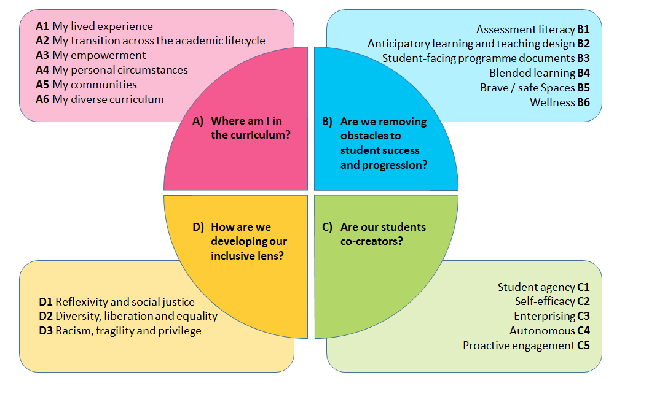
Our UoW Inclusivity Framework

Slide 8
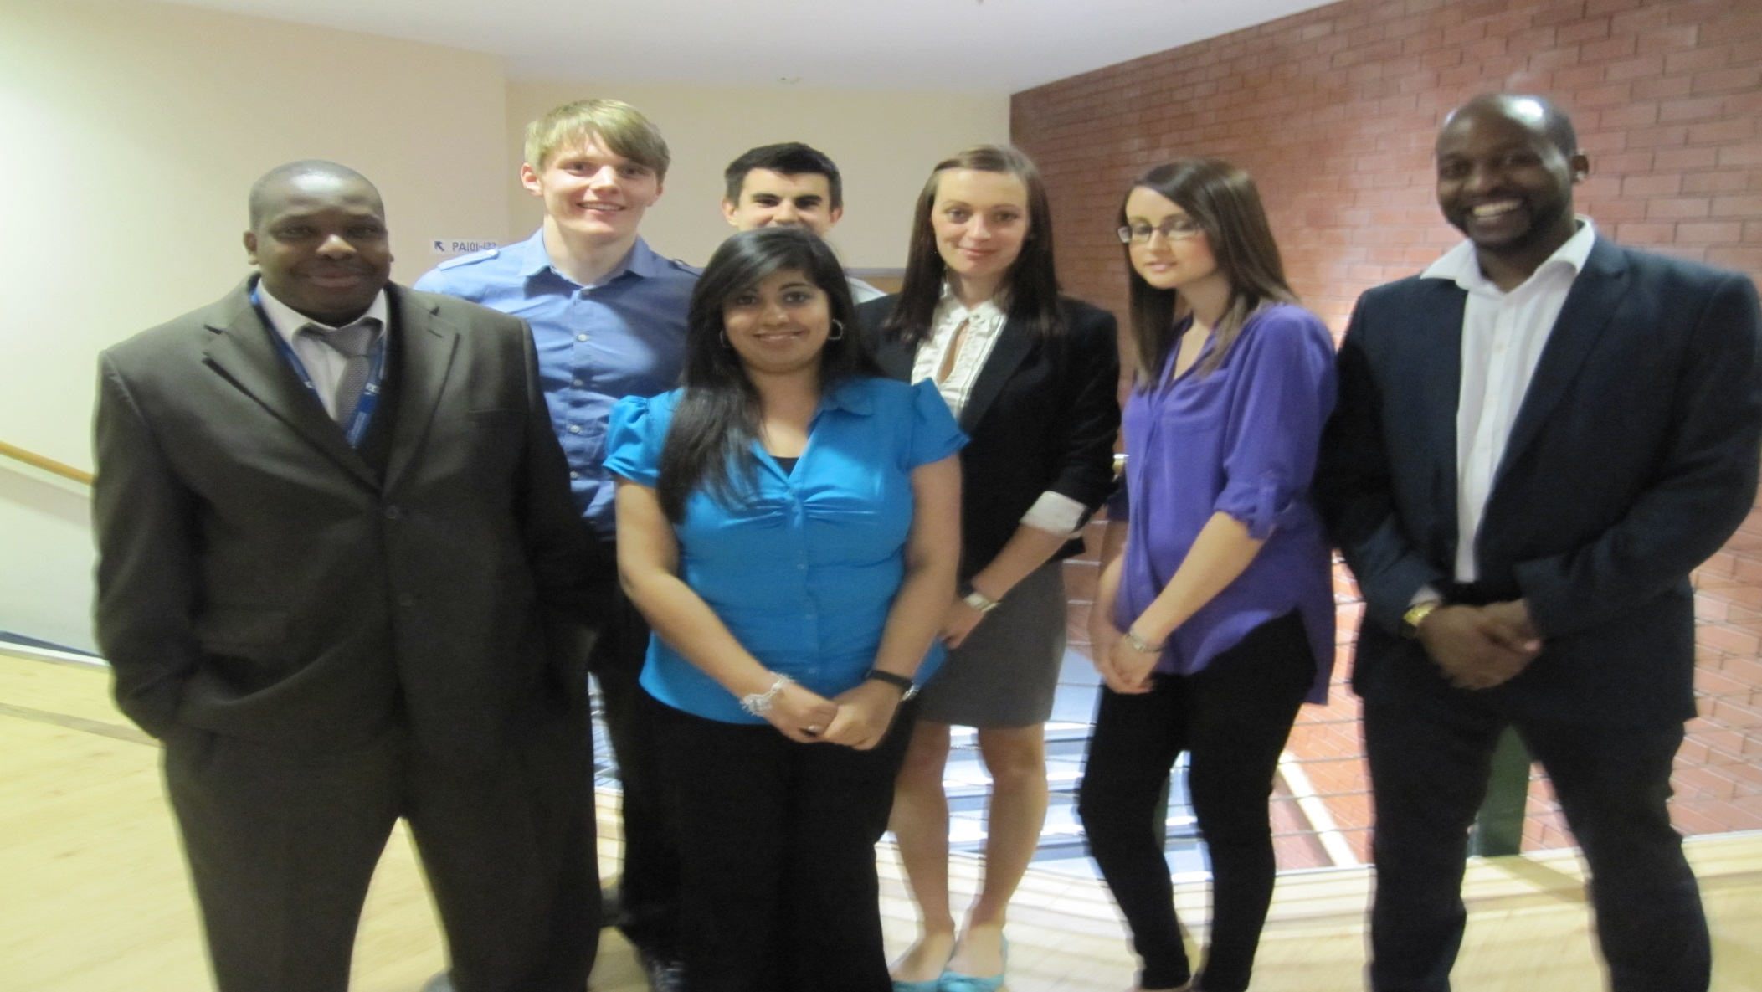
Some of our first IoD student mentees
We have gained so much from the experience; mentors have helped us revisit our strengths and development needs, showed us how to work on some of these, encouraged us to consider what job we REALLY want and introduced us to some additional networks that can help support and guide us towards our career goals.

Slide 9
Our IoD Student Mentoring Scheme
https://youtu.be/3PHlwH7QOVc
The purpose
One to one employer-student partnership; Directors as ‘critical friends’
Recognising/supporting/developing employability skills and beyond
The people
50 mentors & 500+ mentees (final year students) so far, over 14 yrs
The process
Students complete short application form about what want from mentors
Students matched with a mentor in their aspirational/future job role, (if poss)
Mentors ‘briefed/trained’ and students attend a short expectations session
Students and mentors meet for 1:1s/group catch up sessions
Duration: 8 months (Oct 2024 to May 2025)

Slide 10
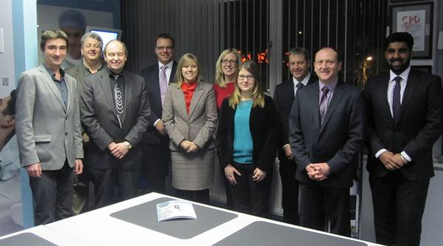
Speed mentoring/mock interview practice with mentors http://issuu.com/universityofwolverhampton/docs/uwbs_ug_student_newsletter_spring_2013?mode=window

Slide 11
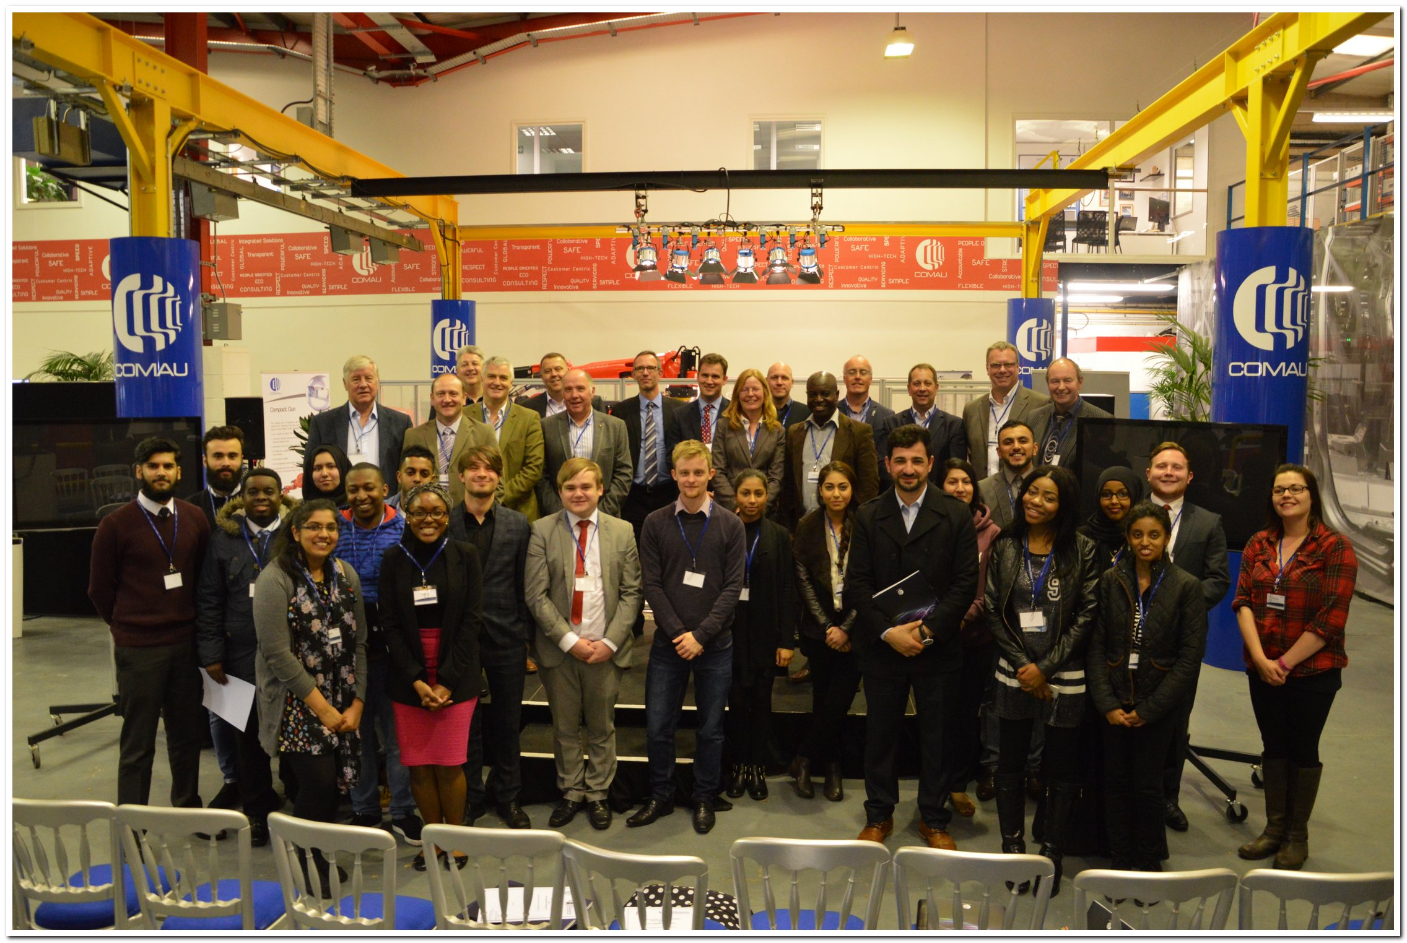
CELEBRATION EVENT

Slide 12
The focus is on BUILDING CONFIDENCE, developing their EMPLOYABILITY SKILLS and getting them into HIGHLY SKILLED EMPLOYMENT

Slide 13
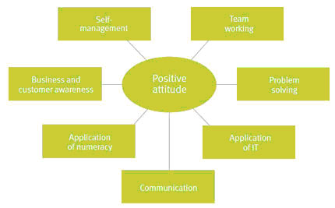
Employability is… http://www.nus.org.uk/Global/CBI_NUS_Employability%20report_May%202011.pdf (CBI/NUS report)

Slide 14
The process…
During mentoring
(1 hour) meeting once a month
In addition (if at all possible):
Meeting senior colleagues/using mentor networks to meet helpful others
Tours of local workplaces
Mini-work experience sessions or placements for students
CV and mock interview sessions in their workplace
Invites to IoD regional/local events
Successes beyond mentoring
@ 80% mentees achieve a good honours degree
@ 30% mentees are awarded University special prizes
IoD (West Midlands) Director of the Year Awards often given to mentors
Over 80% of those mentored are now in ‘highly skilled’ employment
Example 1 – Davinder now working as a Consultant for PWC
Example 2 - Mike now running his own clothing business
Example 3 – James on the Nationwide Graduate Scheme
Example 4 – Julia on KPMG Graduate Scheme https://youtu.be/fz1dGQFbuGo

Slide 15
What is learnt by both parties?
Students/mentees
What employers need and want and what they (the students) really need and want
How different departments and different companies operate
How to focus on strengths within your CV
Further developed application and interview techniques
Honed employability skills; time management, presentation skills, marketing self
Increased self confidence
Awareness of (graduate) job opportunities in the West Midlands and beyond
The importance of networking
Mentors
What are students differing needs and wants
The different strengths that different generations bring
An insight into different countries, different cultures, different perspectives
New knowledge in relation to business (e.g. digital marketing techniques)
Developed mentoring skills, including flexibility/adaptability – one size does not fit all

Slide 16
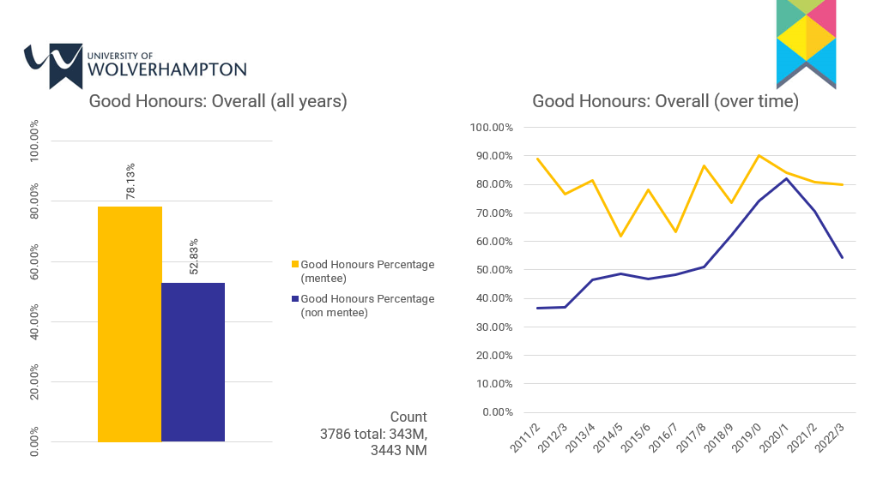
Some recent revelations
These results show that you are more likely to get a good honours degree,
if you are mentored by this scheme…as it builds confidence/focus/clarity…

Slide 17
Some feedback
“In my opinion I think the scheme has been great, and I would have missed out a lot if I didn't take part in it. I feel like it's complimented my third year of Uni as its given it more substance than just studying, but hasn't taken loads of time out of it at all. Most importantly, I feel the scheme has been motivating, which is the best thing for my third year, as meeting the Directors (such as the speed mentoring and an event John has invited me to) has also inspired me to work hard. Which is great as it's easy to lose motivation when there's a lot going on. John has been a great mentor, I only have positive things to say about him! He's very friendly, responsive and genuine! I couldn't have asked for anything more from him honestly, he's really guided me in terms of a career path, improved my confidence so much and helped me with a CV. I'm super grateful for all his help as he is extremely busy. He always stresses if I need help he will try his best to arrange a meeting/phone call, which he does. I think it's a brilliant scheme for third year students, to give them an edge, motivation, confidence and that this should be stressed more to the next third year!” (Mentee)
“I have loved every minute of it as it is very fulfilling, I am actually surprised why this type of initiative is actually not embedded more in education at all levels using people with business experience. I believe it makes a massive difference in getting students into employment.” (Mentor)

Slide 18
Typical feedback
Mentees
Mentors
‘I’m getting to know what I’m good at.’
‘I’ve learnt how to manage my time and workload effectively.’
‘I’ve learnt that I can go for graduate jobs’
‘I would have liked more meetings but recognise my mentor is busy.’
‘Some mentors were more accessible and flexible about meeting up than others.’
‘Some Mentors did more than others; I was happy with my mentor until I heard that others had a mentor who did so much more.’
‘I have learnt that there is so much involved in degree studies.’
‘It’s pleasing to work with mentees that have so much enthusiasm for improving their life and who are focused on achieving.’
‘I have learnt about the complexities of student lives!’
‘My mentee was wanting to discuss her dissertation. I needed to remind them a few times that I’m here to discuss their employability and job opportunities, and not student work.’
‘Don’t do too much for your mentee…need to check motivation.’

Slide 19
Expectations/Responsibilities
The University/The IoD (West Midlands)
To support students beyond the classroom teaching
To share/offer real life knowledge/experiences for students
To build student’s networks
To enhance the support offered by University Careers
Students
To put themselves in a better position to get the job of their dreams
To develop employability skills, particularly in relation to marketing self
To have a fantastic CV and apply for and be prepared for the right jobs
To learn from ‘role models’
Mentors
To meet their student regularly
To share real life experiences and enthusiasm for business
To offer practical advice
To open doors/to give something back to the West Midlands

Slide 20
An overview of mentoring

Slide 21



So what is mentoring?

Slide 22
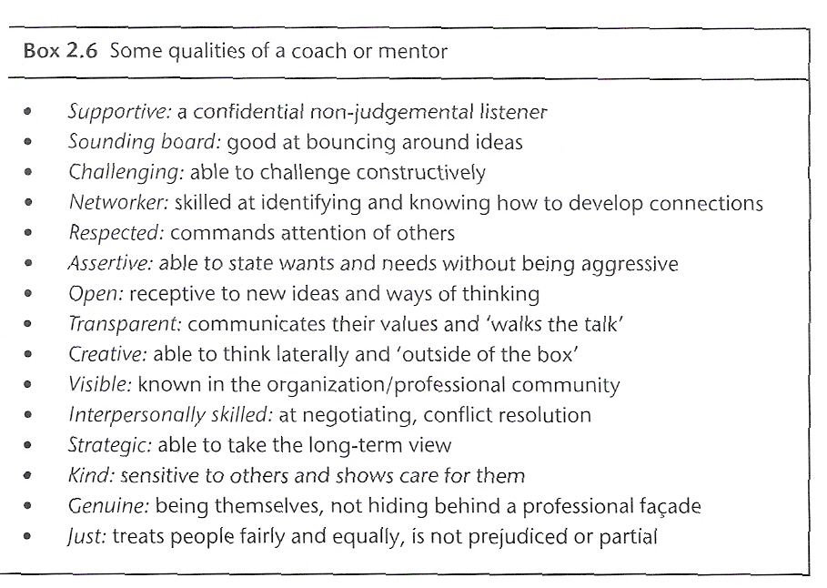
Qualities of coach or mentor (Connor & Pokora)

Slide 23

Ideas for mentoring students
Start with developing an understanding/rapport/relationship
Be open to hearing about their different ‘lived’ experiences
what’s worked for you, may not work for them
‘one size does not/will not fit all’
Be clear about boundaries
theirs and your work-life balance 4 Things You Thought Were True About Managing Millennials (hbr.org)
Check for motivation
strength-based view/up the praise
don’t be too pushy
Busy people/complex lives (you & them!) = it’s their final year
Tempting to be proactive but resist the urge to do everything for them
Not every ‘win’ is tangible – key learning is around confidence
They have lots of other help eg CL/ML, Personal Tutors, Careers, Counselling
They don’t often access this help, particularly Careers = need signposting!
2 emails and then leave it with them! ☺ (then send me an email, please)

Slide 24
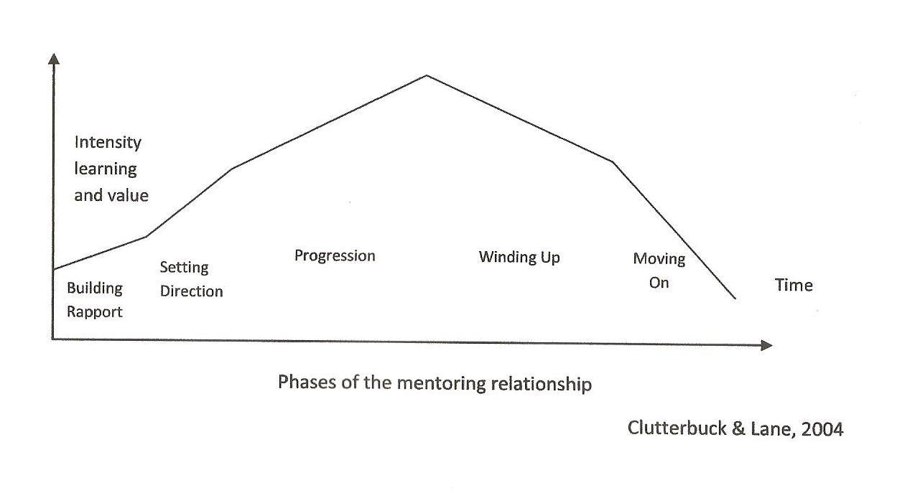
5 phases of the mentoring relationship
Taken from: http://www.nuigalway.ie/staffdevelopment/documents/the_mentoring_life_cycle_v2.pdf

Slide 25
Coaching & Mentoring Processes
Create rapport
Formulate general objectives
Assess the ‘here’ & ‘now’
Decide on the ‘there’ and ‘then’
Formulate clear objectives
Plan a bridge between ‘now’ & ‘then’
Build the bridges
Assess progress
MacLennan

Slide 26
Suggested structure/themes for each mentoring meeting
Mtg 1 – get to know each other/expectations and career aspirations?
Mtg 2 – start to talk about employability skills/career/create an action plan
Mtg 3 – develop an action plan – strengths/development needs/CV?
Mtg 4 – start to re-develop CV and discuss career opportunities
Mtg 5 – review CV and action plan – progress/job search strategies
Mtg 6 – discuss interview skills/practice and job applications
Mtg 7 - discuss how best to market self/future job search strategies
Mtg 8 – review action plan and reflect on progress/feedback/formal end
Please see ‘Scheme Guidelines’ on the website (in MENTOR ZONE)

Slide 27
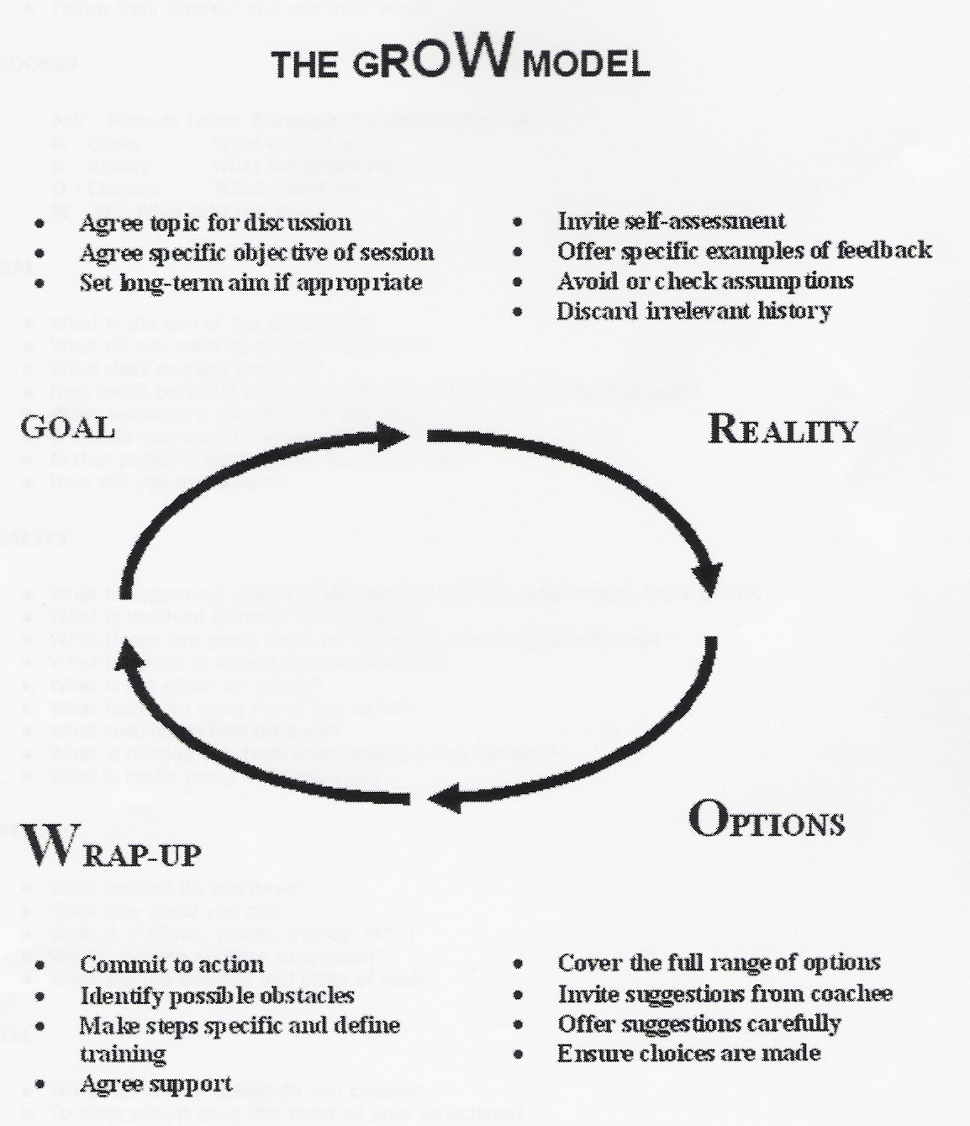
The (infamous) GROW model Downey & Whitmore
Wrap up or will?

Slide 28
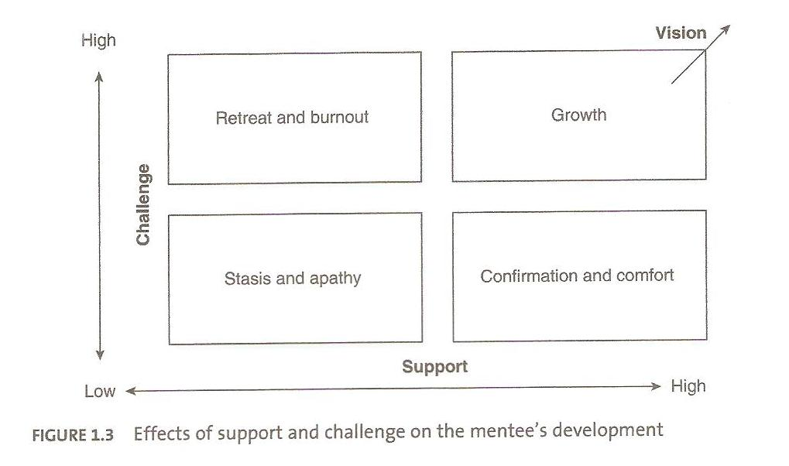
The support and challenge model http://www.sagepub.com/upm-data/39882_9780857024190.pdf (pg 37)

Slide 29
So what is mentoring?

Slide 30
‘It is better to teach people to fish, than to give them a fish’ Mayo & Lang

Slide 31
John’s experiences
John Phillips Mobile 07703 355891 or John@compliancestudio.co.uk

Slide 32
The EMCC Global Code of Ethics
https://emccuk.org/Public/Accreditation/Global_Code_of_Ethics.aspx and Global_Code_of_Ethics_EN_v3.pdf (emccuk.org)
Therefore, we have a brief mentoring contract or agreement to be signed (and passed back to me) at the first session too
Please see ‘Contract’ on the website (in MENTOR ZONE)

Slide 33
Careers
At Careers, Enterprise and the Workplace we understand that many students come to the University of Wolverhampton not just for their interest in a subject but because they want a successful career and a better life. However, with so much going on, it can sometimes be difficult to find the time to focus on what is important for your future.
We recognize that everybody's career needs are different, and you will have a variety of things you want help with, here are some of the things that you can talk to us about:
I don't know what I want to do.
What career options are available with my degree?
Where are the best places to look for jobs?
I know what career I want but I don't know how to get into it.
I'm thinking of starting my own business can you help me?
How do I write a good CV or application form?
I am not sure what I want to talk ?
Careers - University of Wolverhampton (wlv.ac.uk)
Suneeta Duroch
FABSS Careers Development Consultant
Email: s.duroch@wlv.ac.uk
Andrea Woolley Careers, Enterprise & The Workplace, Directorate of Student & Academic Services.
Email: andreawoolley@wlv.ac.uk

Slide 34
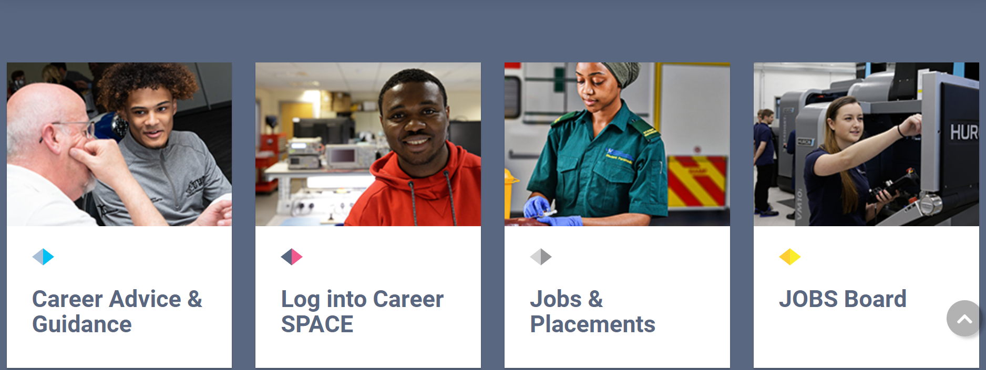
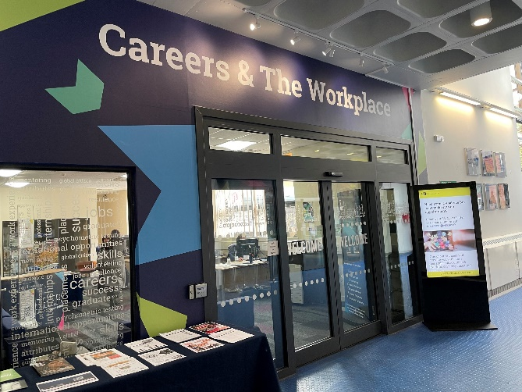
www.wlv.ac.uk/careers
Careers and The Workplace
Ambika Paul building, City campus
CV and interview support
Psychometric testing
Online and in-person bookable appointments
Employer events
Recruitment fair 22-24/10/2024
Part-time jobs
Working in the University
Graduate jobs
Placements (UK and international)
Volunteering opportunities

Slide 35
Additional group get-togethers
Dec - Speed mentoring session re CVs
Feb - Mock interview sessions with Careers
May - Tour and celebration event
All normally late afternoon/evenings (except last session = day)
Please encourage your mentee to come to all of these

Slide 36
THANK YOU FOR SUPPORTING THE CAREER ASPIRATIONS OF OUR STUDENTS Any questions?
https://www.wlv.ac.uk/schools-and-institutes/faculty-of-arts-business-and-social-sciences/university-of-wolverhampton-business-school/employability-and-placement/mentoring/

